Slide 1
BAYES’ RULE AND ITS USE

Slide 2

Bayes’ Theorem
We again consider the conditional probability statement:
P(A|B) = P(A ∩ B)
P(B) = P(A ∩ B)
P(B|A₁)P(A₁) + P(B|A₂)P(A₂) + ··· + P(B|A_{n})P(A_{n})
in which we have used the Theorem of Total Probability to replace P(B). Now
P(A ∩ B) = P(B ∩ A) = P(B|A) × P(A)
Substituting this in the expression for P(A|B) we immediately obtain the result
P(A|B) = P(B|A) × P(A)
P(B|A₁)P(A₁) + P(B|A₂)P(A) + ··· + P(B|A_{n})P(A_{n})
This is true for any event A and so, replacing A by Ai gives the result, known as Bayes’ Theorem
as
P(A_{i}|B) = P(B|A_{i}) × P(A_{i})
P(B|A₁)P(A₁) + P(B|A₂)P(A₂) + ··· + P(B|A_{n})P(A_{n})
₂
This equation is known as Bayes' rule (also Bayes' law or Bayes' theorem).
This simple equation underlies all modern AI systems for probabilistic inference.

Slide 3
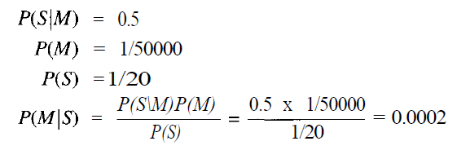
Simple Example Problem
A doctor knows that the disease meningitis is causes the patient to have a stiff neck, say, 50% of the time. The doctor also knows some unconditional facts: the prior probability of a patient having meningitis is 1/50,000, and the prior probability of any patient having a stiff neck is 1/20. Letting S be the proposition that the patient has a stiff neck and M be the proposition that the patient has meningitis.

Slide 4
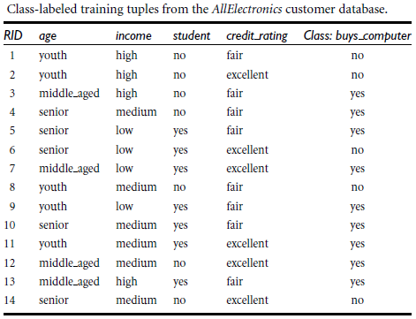
EXAMPLE PROBLEM
The training data are in above Table. The data tuples are described by the attributes age, income, student, and credit rating. The class label attribute, buys computer, has two distinct values (namely, yes, no). Let C₁ correspond to the class buys computer = yes and C₂ correspond to buys computer = no. The tuple we wish to classify is X = (age = youth, income = medium, student = yes, credit rating = fair)

Slide 5
We need to maximize P(X|C_{i})P(C_{i}), for i = 1, 2. P(C_{i}), the prior probability of each class, can be computed based on the training tuples:
    P(buys computer = yes) = 9/14 = 0.643
    P(buys computer = no) = 5/14 = 0.357
To compute P(X|C_{i}), for i = 1, 2, we compute the following conditional probabilities:

Slide 6
P(age = youth | buys computer = yes) = ?
P(age = youth | buys computer = no) = ?
P(income = medium | buys computer = yes) = ?
P(income = medium | buys computer = no) = ?
P(student = yes | buys computer = yes) = ?
P(student = yes | buys computer = no) = ?
P(credit rating = fair | buys computer = yes) = ?
P(credit rating = fair | buys computer = no) = ?
The above full join distribution can be written as

Slide 7
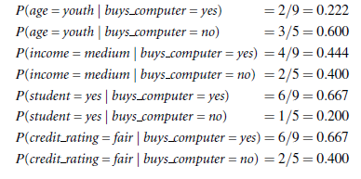

Slide 8

= 0.222 X 0.444 X 0.667 X 0.667 = 0.044
Similarly,
P(X | buys computer = no)
= 0.600 X 0.400 X 0.200 X 0.400 = 0.019
To find the class, Ci, that maximizes P(XjCi)P(Ci), we compute
P(X | buys computer = yes)P(buys computer = yes) = ?
P(X | buys computer = no)P(buys computer = no) = ?

Slide 9
P(X | buys computer = yes)P(buys computer = yes) =0.044 X 0.643 = 0.028
P(X | buys computer = no)P(buys computer = no) =0.0918 X 0.357 = 0.007
Therefore, the naïve Bayesian classifier predicts buys computer = yes for tuple X.

Slide 10
